Slide 1
Stock Price Prediction
An Analysis and Model Deployment

Slide 2
Introduction
The primary objective of this project is to predict the ‘Close' column using various regression modeling techniques to identify the best-performing model based on accuracy and efficiency.
This analysis focuses on the dataset provided, utilizing regression models like Linear Regression, Support Vector Machines, and others. The scope includes data preprocessing, feature engineering, model training, and evaluation. Limitations include potential data quality issues and computational constraints.
The Model is created using the best model and is used to predict the Close price of the stock for the next 5 days.

Slide 3
Data Overview
The dataset used in this project is sourced from Kaggle. The dataset comprises 4140 rows and 15 columns. Each row represents a unique data point, and each column corresponds to a different feature.
Overview of the Features- TCS.csv
The dataset consists of 15 columns:
Date: Date of the record
Symbol: Stock symbol
Series: Series (e.g., EQ for equity)
Prev Close: Previous closing price
Open: Opening price
High: Highest price during the day
Low: Lowest price during the day
Last: Last traded price
Close: Closing price
VWAP: Volume Weighted Average Price
Volume: Number of shares traded……

Slide 4
Turnover: Turnover in terms of value
Trades: Number of trades (with many missing values)
Deliverable Volume: Number of shares delivered
%Deliverable: Percentage of deliverable volume
Steps for Data Preprocessing
1. Load the Data
First, load your dataset using pandas from Google Drive
2. Handle Missing Values
Check for missing values and handle them appropriately. In this example, we'll assume there are no missing values, but if there are, you might want to fill them in or drop the rows/columns:
3. Data Splitting
Split the data into training and testing sets using train_test_split from sklearn.model_selection:

Slide 5
Exploratory Data Analysis (EDA)
By performing these steps in EDA, you can gain a comprehensive understanding of the dataset, identify potential issues, and extract meaningful insights that guide subsequent modeling efforts. The visualizations provide a clear depiction of data distribution, correlations, and relationships between features and the target variable.
Here are some key observations from the dataset:
Missing Values:
The Trades column has 1683 missing values.
Summary Statistics:
The average closing price is around 1694.37 with a standard deviation of 723.06.
The highest price recorded is 3674.80, and the lowest is 358.00.
The volume of shares traded varies widely, with an average of around 1.68 million shares.
The percentage of deliverable volume ranges from 12.14% to 96.22%.

Slide 6
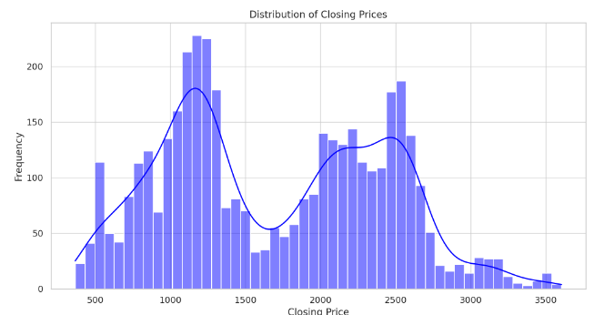
Exploratory Data Analysis (EDA)
Next, let's visualize some key aspects of the data:
Distribution of closing prices.
Time series plot for the closing price and volume.
Distribution of the volume of shares traded.

Slide 7
Model Training
1. Linear Regression Model
Purpose:
Linear regression is used to model the relationship between a dependent variable (target) and one or more independent variables (features). The aim is to predict the target variable, which in this case is the stock "Close" price.
Steps Involved:
Data Splitting: The data is divided into training and testing sets, typically with 80% used for training and 20% for testing.
Feature Scaling: The features are scaled using StandardScaler to ensure they are on the same scale, which helps improve model performance.
Model Training: The linear regression model is trained on the scaled training data.
Evaluation: The model is evaluated on the test set using metrics such as Mean Absolute Error (MAE), Mean Squared Error (MSE), and R-squared (R²).
Prediction: The model predicts the stock "Close" prices for the next 5 days based on the most recent data.

Slide 8
Model Training
2. LSTM (Long Short-Term Memory) Model
Purpose:
LSTM is a type of recurrent neural network (RNN) capable of learning long-term dependencies, making it particularly useful for time series prediction tasks like stock prices.
Steps Involved:
Data Preparation: The "Close" prices are scaled to a range between 0 and 1 using MinMaxScaler, and sequences of data are created to train the LSTM.
Model Architecture: The LSTM model is built with two LSTM layers, each with 50 units, followed by a dense layer to output the predicted value.
Training: The model is trained on the training sequences for a specified number of epochs (e.g., 10 epochs in this case) with a validation split to monitor its performance.
Prediction: The trained LSTM model is used to predict future stock prices, which are then inverse transformed to their original scale for comparison with actual values.

Slide 9
Model Training
3. Random Forest Model
Model Initialization:
A RandomForestRegressor is initialized with specific hyperparameters:
n_estimators=500: The number of trees in the forest.
min_samples_split=2: The minimum number of samples required to split an internal node.
min_samples_leaf=1: The minimum number of samples required to be at a leaf node.
max_features='sqrt': The number of features to consider when looking for the best split.
max_depth=90: The maximum depth of the trees.
bootstrap=True: Whether bootstrap samples are used when building trees.
Model Training:
The model is trained on the training dataset (X_train, y_train) using the fit() method.
Prediction:
The trained model makes predictions on the test dataset (X_test) using the predict() method.

Slide 10
Model Training
4.SVR Model
Model Initialization:
An SVR model is initialized with specific hyperparameters:
C=10: Regularization parameter that controls the trade-off between achieving a low training error and a low testing error that is robust to overfitting.
epsilon=0.01: Defines the epsilon-tube within which no penalty is associated with training losses.
gamma='scale': Kernel coefficient for 'rbf', 'poly', and 'sigmoid'. In this case, the default value of 'scale' is used.
kernel='linear': Specifies the linear kernel function.
Model Training:
The SVR model is trained on the scaled training dataset using fit().
Prediction:
The trained model makes predictions on the scaled test dataset using predict().

Slide 11
Model Training
5. ARIMA (AutoRegressive Integrated Moving Average) model
Data Preparation
Differencing:
Differencing is applied to the Close column to make the time series stationary, which is a requirement for ARIMA modeling. The diff() function computes the difference between consecutive data points, and dropna() is used to remove any resulting NaN values.
Parameter Tuning for ARIMA
Grid Search for ARIMA Parameters:
The ARIMA model requires three parameters: p (autoregressive part), d (differencing part), and q (moving average part).
The ranges for p, d, and q are set as follows:
p = range(0, 6): Autoregressive terms.
d = range(0, 2): Differencing order.
q = range(0, 6): Moving average terms.
A list of all possible combinations of p, d, and q values is created using itertools.product().

Slide 12
Model Evaluation
To evaluate the performance of the five models implemented in the notebook, we can use standard regression performance metrics such as Mean Absolute Error (MAE), Mean Squared Error (MSE), Root Mean Squared Error (RMSE), and R-squared (R²). These metrics provide insights into how well each model predicts the target variable.
The metrics we are considering include Mean Absolute Error (MAE), Mean Squared Error (MSE), Root Mean Squared Error (RMSE), and R-squared (R²).
Evaluation of Models
Linear Regression
MAE: 5.82
MSE: 65.68
R²: 0.99986
LSTM
MAE: 36.60
MSE: 6045.97
RMSE: 77.76
Random Forest Regression
MAE: 4.67
MSE: 49.85
RMSE: 7.06

Slide 13
Best Model Selection: SVR
Support Vector Regression (SVR)
MAE: 3.38
MSE: 23.52
R²: 0.99995
ARIMA
MAE: 38.74
MSE: 2783.51
RMSE: 52.76
Selecting the Best Model
The best model should have the lowest MAE, MSE, and RMSE values, which indicate lower prediction errors, and the highest R-squared value, indicating a better fit to the data.
Conclusion
The Support Vector Regression (SVR) model performs the best overall, as it has the lowest MAE and MSE, indicating the smallest prediction errors, and the highest R² value, indicating the best fit to the data.
Overall, Support Vector Regression (SVR) is the recommended choice based on the evaluation metrics provided. If interpretability or computational efficiency were considerations, other models might be chosen, but purely based on prediction performance, SVR is superior.

Slide 14
Deployment
1. Model Training and Saving:
Trained the Random Forest model on the training dataset.
Saved the trained model using joblib for later use in the web application.
2.Setting Up Streamlit Application:
Created a Streamlit application (app.py) to serve the model and allow users to input features and get predictions.
3. Setting Up Ngrok for Public Access:
Used Ngrok to create a secure tunnel to the Streamlit application, making it accessible over the internet.
4. Running the Application:
Executed the Python script to launch the Streamlit application and establish the Ngrok tunnel.
Link to the Web Application
The web application is hosted using Ngrok and can be accessed via the following URL:
Streamlit app is live at NgrokTunnel: "https://d625-34-27-126-2.ngrok-free.app" -> "http://localhost:8501"

Slide 15
Difficulties
Lot of difficulties were faced while the execution of this project and some of the prime
Difficulties are listed below.
Hyperparameter Tuning: Finding the optimal hyper parameters for the chosen model requires extensive experimentation and cross-validation, which is computationally intensive. For eg. For Random forest hyper parameter tuning, the computation was taking lot of time of more than 12 hours in colab . And hence colab runtime was disconnecting even before the execution completes. And then execution had to restart again multiple times.
The issue was finally solved by performing the Hyper parameter tuning part locally in laptop using the Jupyter note. Since it was done locally, the timeout issue found in colab was solved

Slide 16
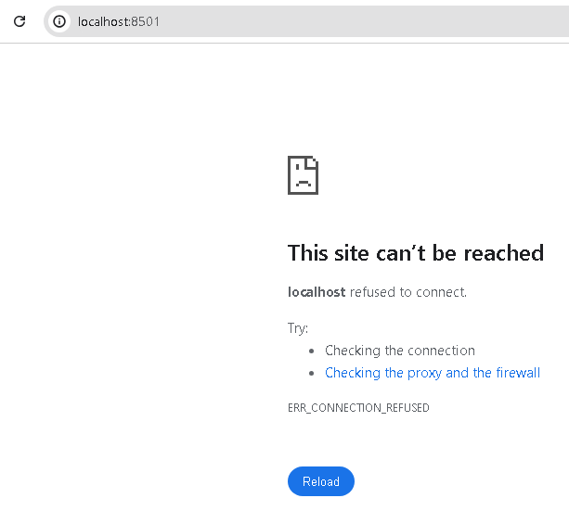
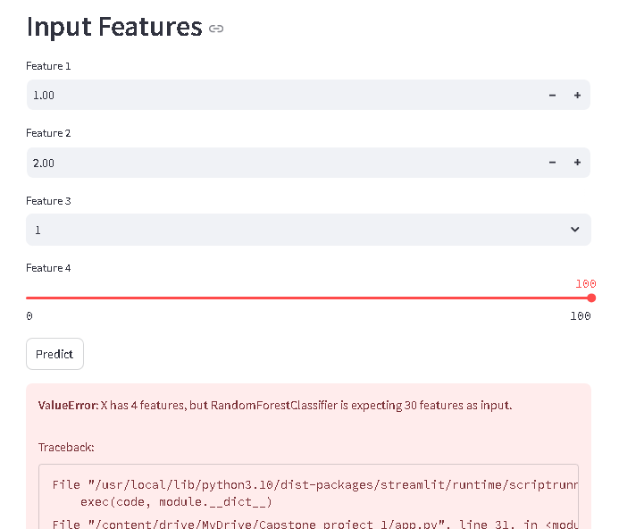
Difficulties
2. Deployment: During deployment , the streamlit app was giving multiple issues.
1) Initially link was not working and the page was not loading
2) Incomplete Interface was visible as complete feature were not available as in below
image.

Slide 17
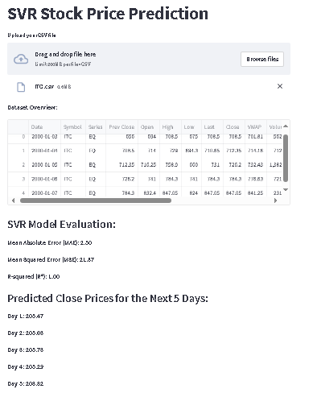
Result
The stock price prediction was done for different stock (ITC) and result came close to the actual price as seen in below images in the stream lit app.

Slide 18
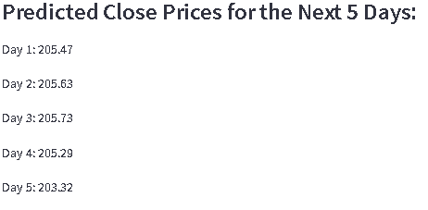
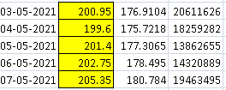
Result
Once CSV is uploaded to the streamlit app, it analyses the data using SVR model and evaluates the model as well as predict the Close price of next 5 days also.
The stock price prediction result came with some difference. Stock close prices can't be predicted with 100% accuracy. Financial markets are influenced by a vast number of factors, including economic indicators, market sentiment, geopolitical events, and even random noise. While models and analyses can provide probabilities and insights, they can't account for every variable or unforeseen event. Predicting stock prices involves dealing with a significant amount of uncertainty and risk.
App predicted Close price
Real world Close price

Slide 19
THANKS

